Slide 1
Exploring Sitecore Xconnect
Building an offline visitor’s profile.
September 10, 2018
Notes:
The Studio PowerPoint Templates page: https://sp.slalom.com/ourfirm/studio/SitePages/templates.aspx

Slide 2

First, what’s Xconnect?
Really, it’s just a REST API, with one purpose: to capture and report analytics and user experience data.
But for Sitecore, this one purpose enables new opportunities.
slalom.com

Slide 3
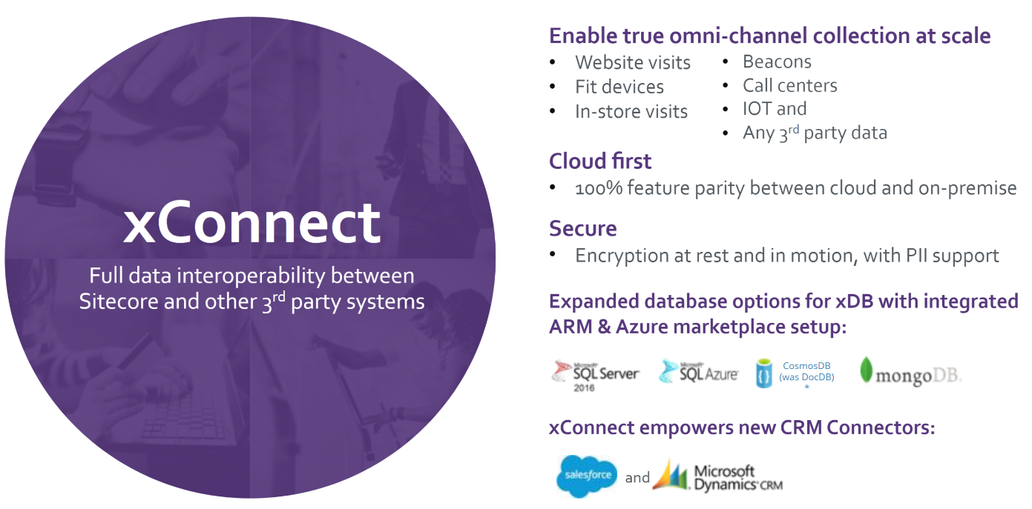
Sitecore 9 Partners Intro webinar

Slide 4

Well now it can.
Sitecore 8 xDB had good intentions, but admittedly also a few short comings. They all have been redesigned and ready to use in Sitecore 9.
Easy to implement, easy to use
Developer Documentation
Omni-channel ready & customizable
REST APIs
Supports EU GDPR regulations
Scalable & Cloud Ready
Secure and fully integrated
4

Slide 5
100%
Contact, Interaction, Event & Goal
Notes:
Solid fill boxes
Light grey lines

Slide 6
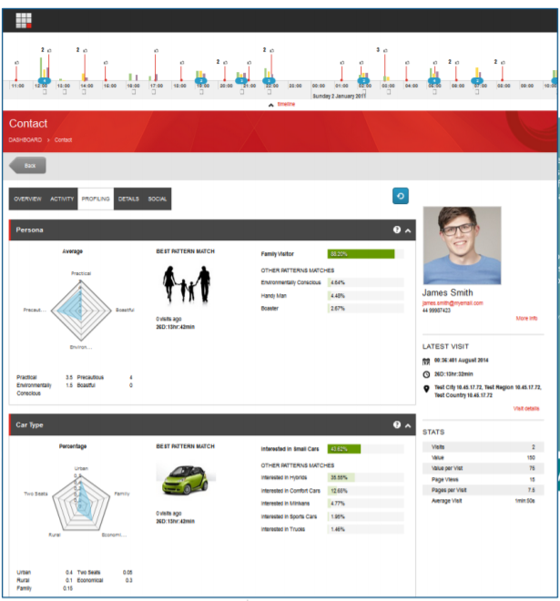
100%
All together in one interface
View both standard and custom facets
View interactions and events
Goals & Channels
Enable automation and rules
Notes:
Solid fill boxes
Light grey lines

Slide 7
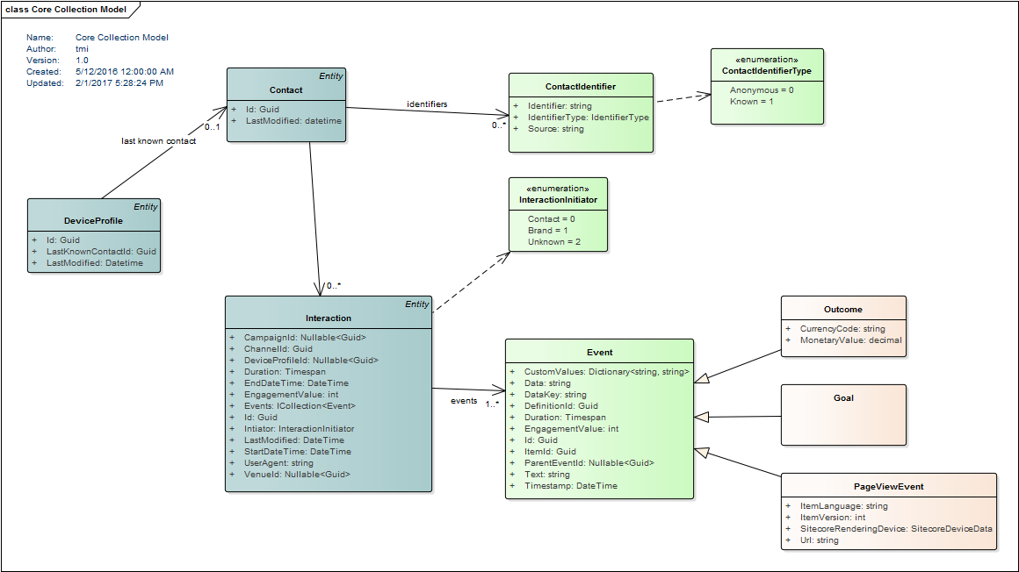
Less is really more!
A third of the code lets you create efficient, easy
to manage implementations, from virtually
any other application.

Slide 8
A lot less time coding
Compared to Sitecore 8 xDB, adding a contact with Xconnect is a walk in the park.
public void SetContactData(string username)
{
LeaseOwner leaseOwner = new LeaseOwner("YOUR_WORKER_NAME", LeaseOwnerType.OutOfRequestWorker);
ContactRepositoryBase contactRepository = Factory.CreateObject("contactRepository", true) as ContactRepositoryBase;
// Attempt to obtain an exclusive lock on an existing contact in xDB.
LockAttemptResult<Contact> lockResult = contactRepository.TryLoadContact(username, leaseOwner, TimeSpan.FromMinutes(1));
Contact contact = null;
if (lockResult.Status == LockAttemptStatus.AlreadyLocked)
{
// Another worker or a live web session has an exclusive lock on the contact.
// You can't use this contact right now. It's up to you what to do in this case.
/* ... */
}
else if (lockResult.Status == LockAttemptStatus.DatabaseUnavailable)
{
// Database is down. Try to handle this gracefully.
/* ... */
}
else if (lockResult.Status == LockAttemptStatus.NotFound)
{
// A contact with the given identifier doesn't exist.
// Just create a new contact object.
contact = contactRepository.CreateContact(Guid.NewGuid());
// Identify it.
contact.Identifiers.Identifier = username;
// And make it known.
contact.Identifiers.IdentificationLevel = Sitecore.Analytics.Model.ContactIdentificationLevel.Known;
}
else
{
// We successfull locked an existing contact.
contact = lockResult.Object;
}…
public void UpdateContact(string source, string identifier, Data data)
{
using (XConnectClient client = GetClient())
{
IdentifiedContactReference reference = new IdentifiedContactReference(source, identifier);
Contact contact = client.Get<Contact>(reference, new ContactExpandOptions(PersonalInformation.DefaultFacetKey));
if (contact == null)
{
return;
}
// Set Facets
client.SetFacet<PersonalInformation>(contact, PersonalInformation.DefaultFacetKey, personalInformation);
client.Submit();
}
}
Editing a xDB Contact in Sitecore 8
Editing a Contact with XConnect

Slide 9
An offline UWP app, a couple MVC sites, Xconnect and some visitor’s experiences.

Slide 10
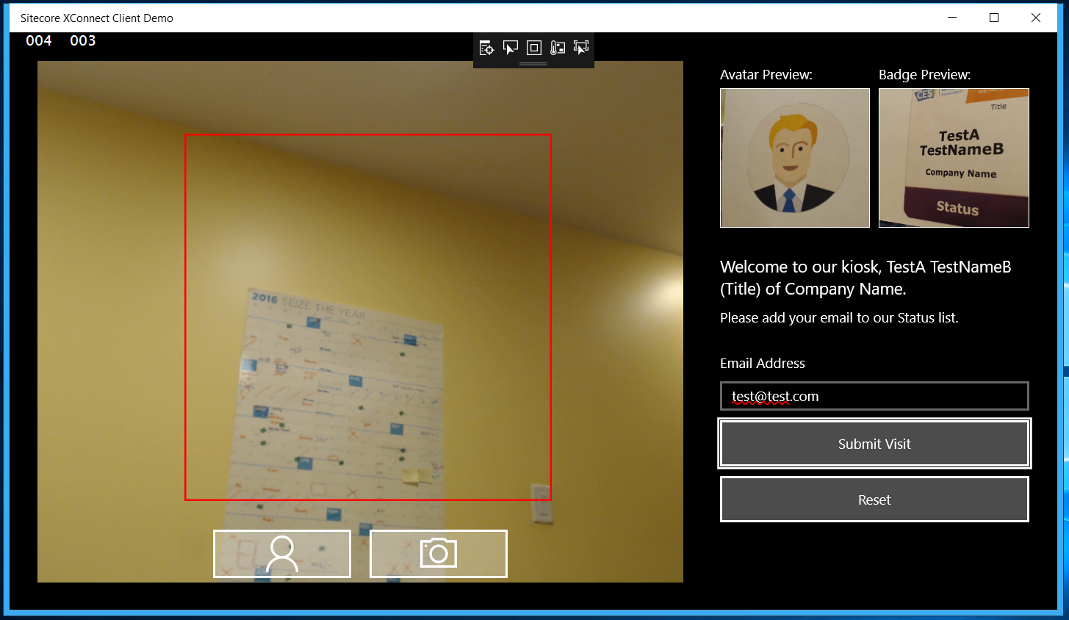
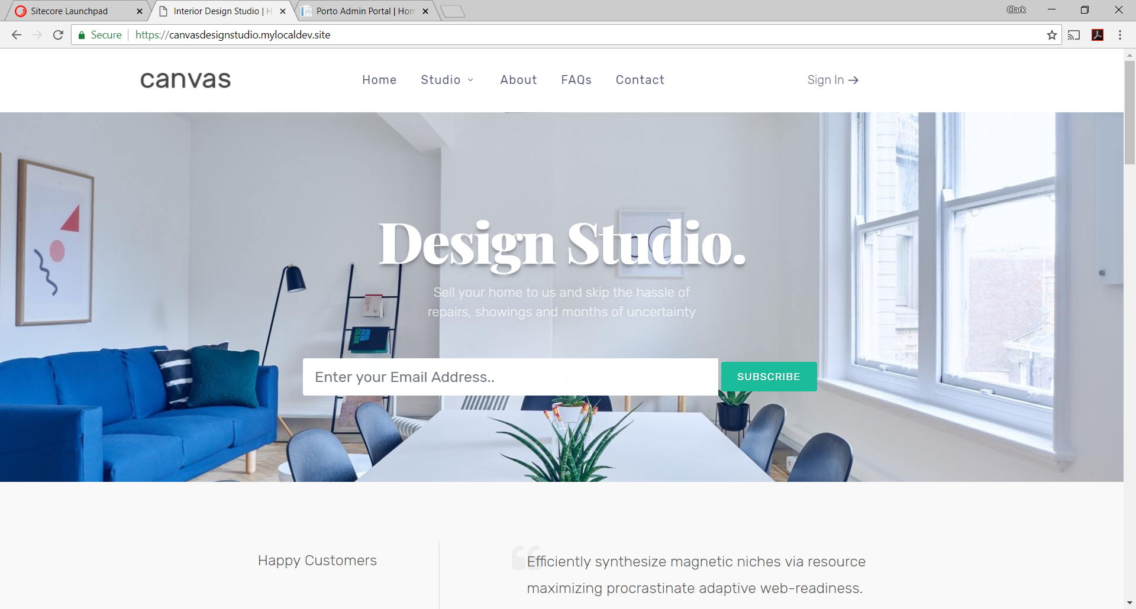
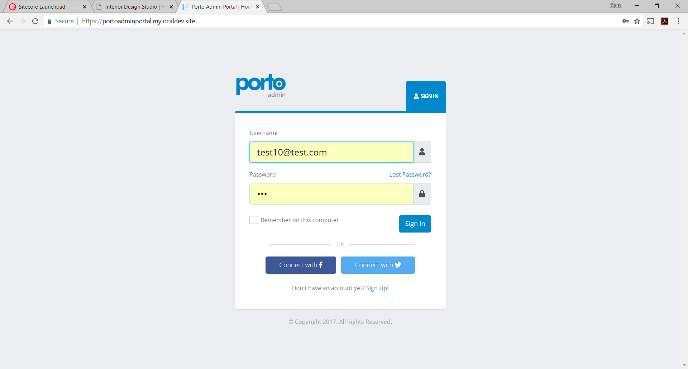
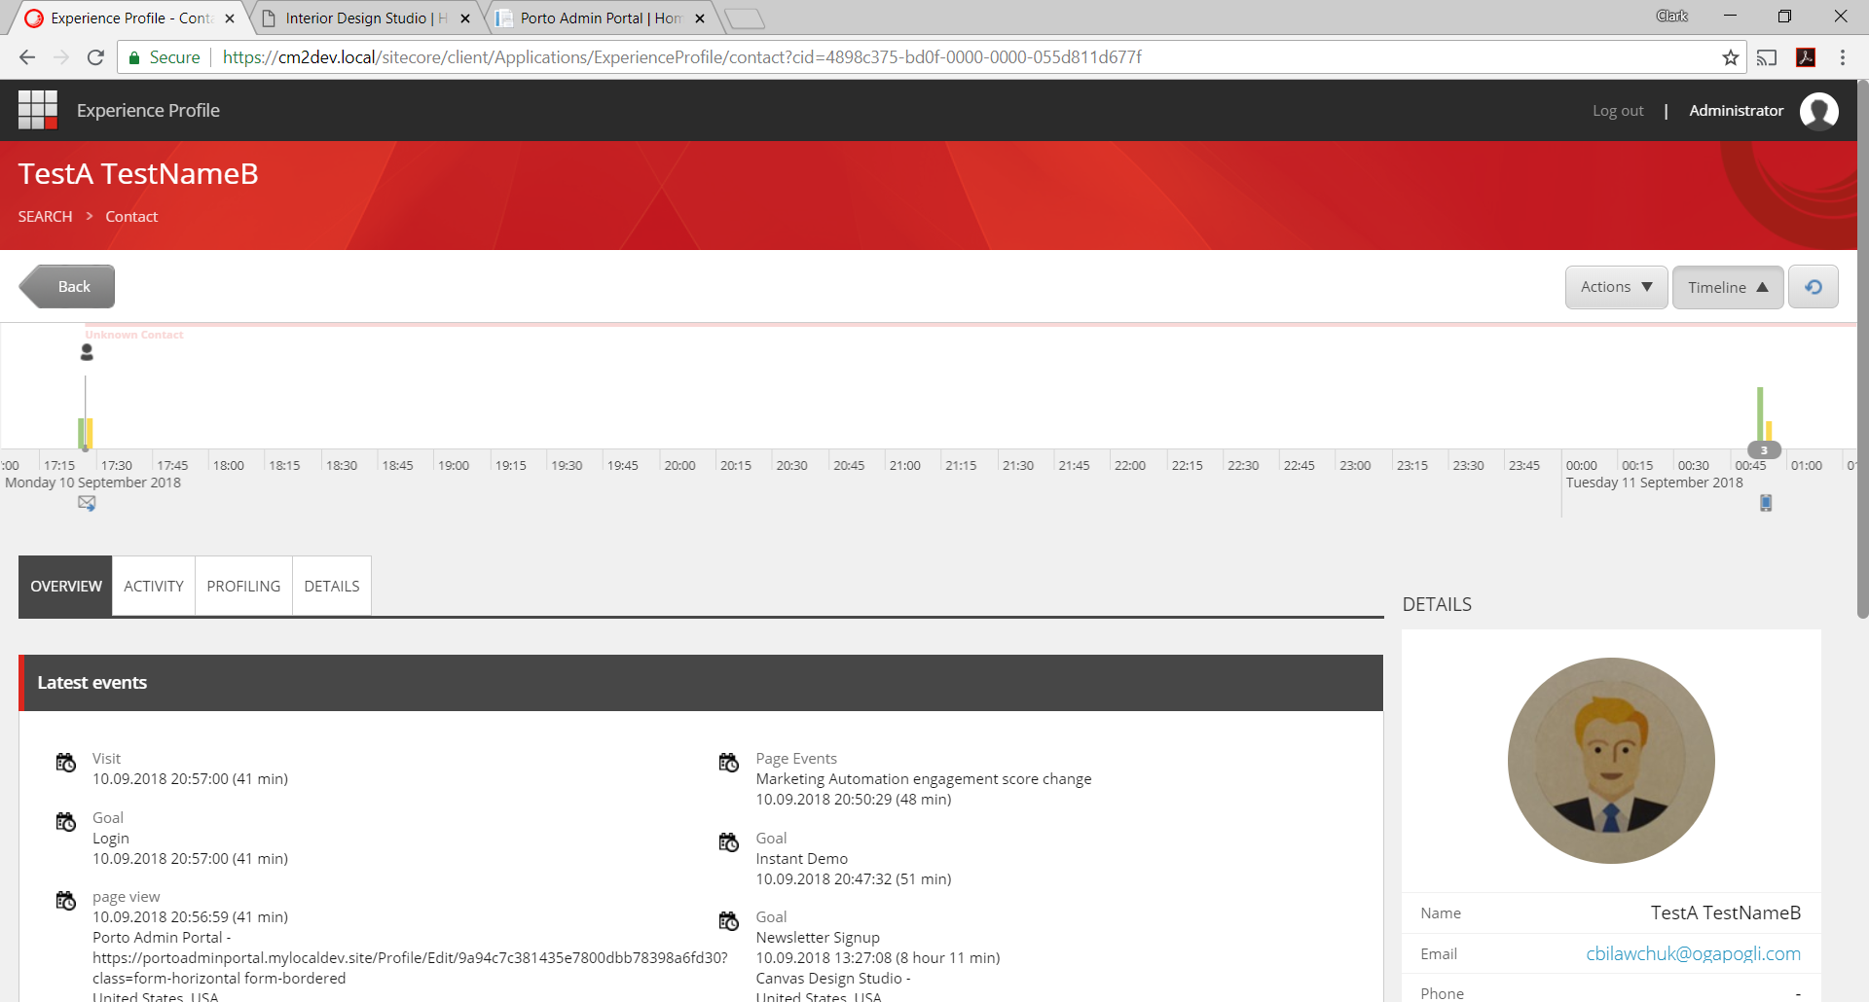
For the live demo…
2
Starting with a unknown contact to an offline experience and back.
1
UWP Camera App with OCR & Face Detection
MVC Site
Newsletter Subscription
3
4
MVC Site
Admin Portal with profile management
Sitecore 9 with Xconnect

Slide 11
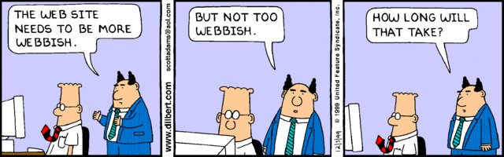
Questions?
slalom.com
Notes:
Quote Sample

